Slide 1
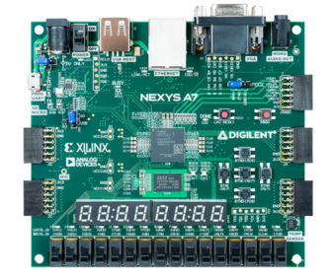
8-Bit SAP-1 CPU
CE221 – Digital Logic Design
Design and Implementation of a SAP-1 Architecture on FPGA using
Verilog
Syed Zain Ali Shah Bokhari (2024623)
Shayan Rizwan Yazdanie (2024585)

Slide 2
Motivation
This project was motivated by the goal of implementing a hardware system that mirrors the foundational architecture of modern computers.
The SAP-1 architecture stood out due to its simplicity, clarity, and strong documentation—most notably Ben Eater’s breadboard implementation—which made the learning, design, and execution both intuitive and engaging.
Additionally, this project serves as a strong portfolio piece, integrating all the core concepts studied in the Digital Logic Design (DLD) course.

Slide 3
What is SAP-1?
The Simple-As-Possible (SAP)-1 computer is a very basic model of a microprocessor explained by Albert Paul Malvino. The SAP-1 design contains the basic necessities for a functional Microprocessor. Its primary purpose is to develop a basic understanding of how a microprocessor works, interacts with memory and other parts of the system like input and output. The instruction set is kept simple.
Key DLD idea: SAP-1 is a synchronous sequential system.

Slide 4
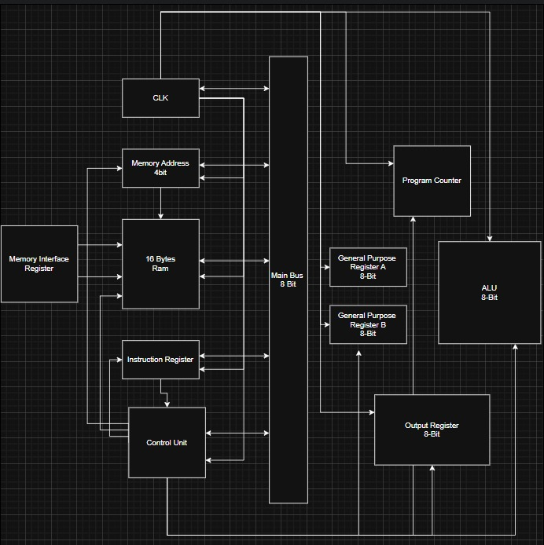
SAP-1 Architecture Overview
8-bit single-bus CPU based on SAP-1
Centralized Control Unit implemented as an FSM
Register-based datapath (PC, MAR, IR, A, B, OUT)
Shared 8-bit tri-state bus (no contention)
ROM-based instruction and data storage
A pictorial representation of its architecture is shown on the right

Slide 5
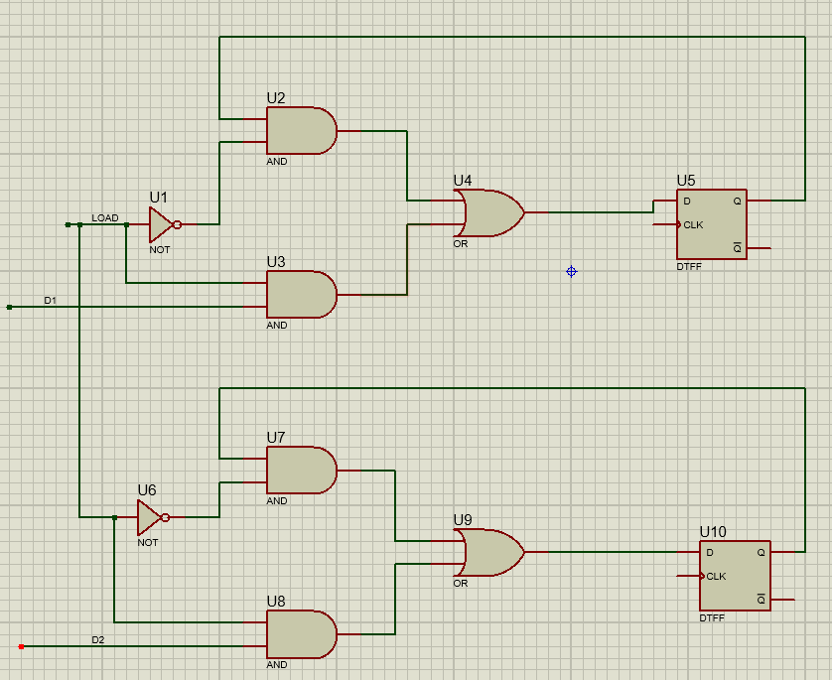
8-Bit System Bus
Single shared 8-bit data bus
Only one module drives the bus at a time
Tri-state buffers prevent bus contention
Control unit enforces bus access rules
All registers are implemented using D flip-flops and operate synchronously under a single global clock to ensure coordinated data movement across the system.
Each register supports controlled loading and bus driving through explicit load and output-enable signals generated by the control FSM, preventing bus contention and ensuring deterministic operation.
Circuit-level design of the mechanism of loading the value into the register
[Made In Proteus]

Slide 6
Instruction Format (8-bit)
Operation | Description
Load | Load data from memory to the accumulator
Add | Add data from memory to value in the accumulator
Subtract | Subtract data from memory from value in the accumulator
Output | Load data from accumulator to the output register
Halt | Stop processing
The instruction set of a computer are the basic operations it can perform. The instruction set of the SAP-1 is described in table on the right.
8 Bit Instruction Code
Upper nibble: opcode
Lower nibble: memory address

Slide 7
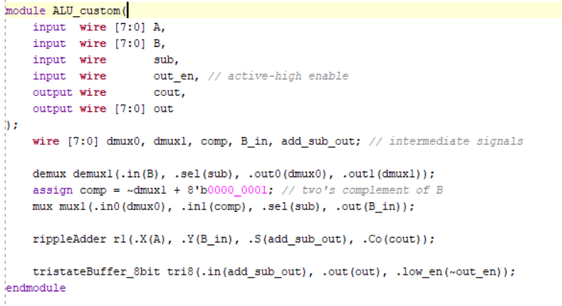
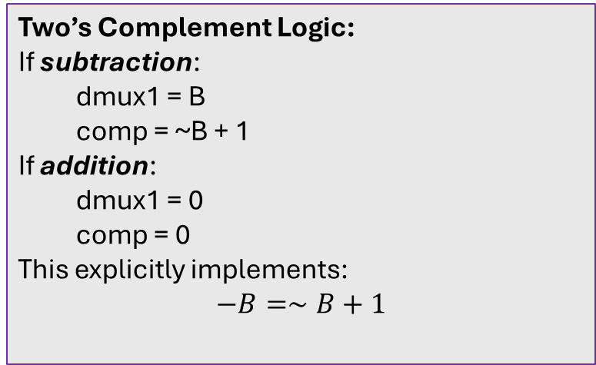
ALU Design
It is a 1-bit signal, equivalent to SU (Subtract Enable) in SAP-1.
0 – A+B
1 – A-B
Instead of conditionally inverting B inside the adder, we route B through demultiplexers and multiplexers before the adder.
Two’s Complement Logic:
If subtraction:
  dmux1 = B
  comp = ~B + 1
If addition:
  dmux1 = 0
  comp = 0
This explicitly implements:
$$−B=∼B+1$$
The custom ALU implements 8-bit addition and subtraction using explicit demultiplexing and two’s complement logic, with tri-state output control to support a shared SAP-1 system bus.

